Slide 1
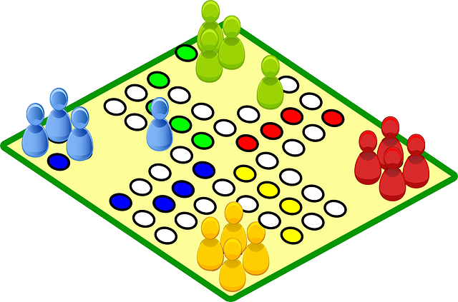
Mrs. Rhodes’
November 6 - 10, 2023
READING
Unit 4: Different Perspectives, Different Points of View
- Draw Inferences - Point of View - Similes and Metaphors
WORD STUDY
Unit 4 Week 3
Vowel Team Syllables
- Read and spell words with vowel team syllables.
Examples: coach, exhausted, release, remaining, toilet, youth, highlight, oatmeal
GRAMMAR
Multisensory Language – Prepositions and Conjunctions
- Identify, read, and write conjunctions.
MATH
Topic 8 Use Strategies and Properties to Add and Subtract
Addition Properties
Addition and Subtraction
Round Whole Numbers
Estimate Sums and Differences
SCIENCE/ SOCIAL STUDIES
Veteran’s Day
REMINDERS
Read 20 minutes each night and record in reading log
Practice math facts
Math wkst each night
Read Automaticity sheet
Practice word study skills
Review vocabulary words
Please check Pride Binder each night.
WHAT WE’RE LEARNING
IMPORTANT DATES
November 10th – No School
November 15th – Progress Reports
November 22⁻24 – No School
December 7th - Nutcracker
December 15th – End of 2nd Nine Weeks
UPCOMING ASSESSMENTS
Nov. 8 - ½ Reading Test
Nov. 8 - Vocabulary Test
Nov. 9 - ½ Reading Test
Nov. 9 - Word Study Test
Nov. 17 - Reading Quiz
Nov. 17 - Topic 8 Math Test
Email: mkrhodes@auburnschools.org
Phone: 334-887-2110

